Slide 1
Bellabeat Case Study Presentation
Prepared by: Mohammad Mohidul Islam

Slide 2
Bellabeat Case Study Presentation
Title: Bellabeat Case Study: Data-Driven Marketing Insights
Subtitle: Leveraging Smart Device Data to Inform Marketing Strategy
Prepared by: Mohammad Mohidul Islam | Junior Data Analyst

Slide 3
Business Task
Objective:
Analyze smart device data to uncover user behavior trends.
Apply insights to Bellabeat's product, Leaf, to guide marketing strategies.
Key Business Questions:
What are the trends in smart device usage?
How can these trends apply to Bellabeat customers?
What marketing actions can we recommend?

Slide 4

Data Sources
Primary Dataset: Fitbit Fitness Tracker Data (Kaggle, Public Domain)
Data Files Used:
dailyActivity_merged.csv
hourlySteps_merged.csv
sleepDay_merged.csv
Limitations:
Small sample size (30 users)
Data collected in 2016

Slide 5

Data Analysis Tools & Process
Tools: RStudio, ggplot2, dplyr
Steps Taken:
Data cleaning: Removed duplicates, handled missing values.
Merged datasets for comprehensive analysis.
Calculated averages, correlations, and identified trends.

Slide 6
Key Insights
Activity Trends:
Average 7,600 steps/day.
Peak activity: 7-9 AM & 6-9 PM.
Calories Burned:
Directly proportional to daily steps.
Sleep Patterns:
Average ~7 hours of sleep.
Active users have better sleep efficiency.

Slide 7
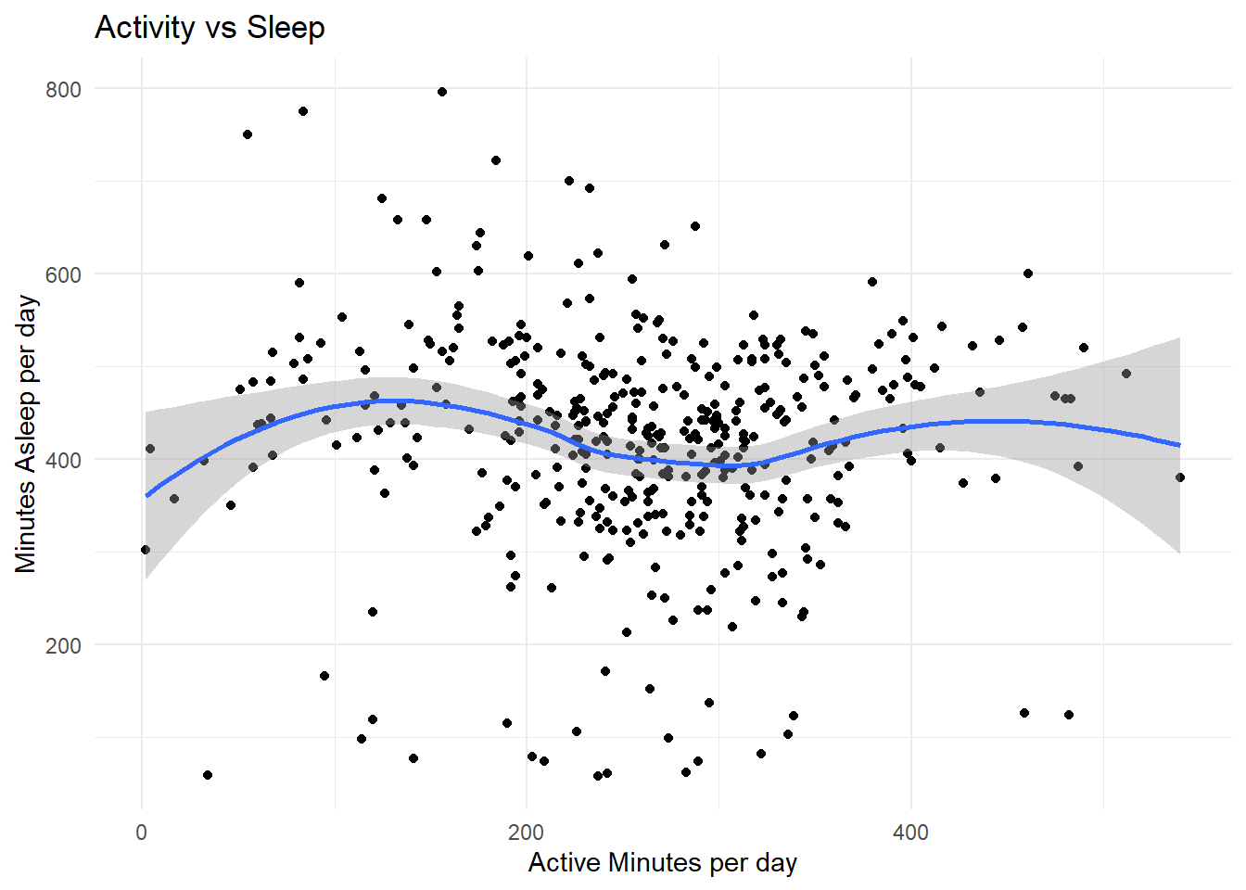
Visualizations
Insights: There is a positive correlation found, Bellabeat can prompt a message that “More daily activity can improve sleep duration or quality

Slide 8
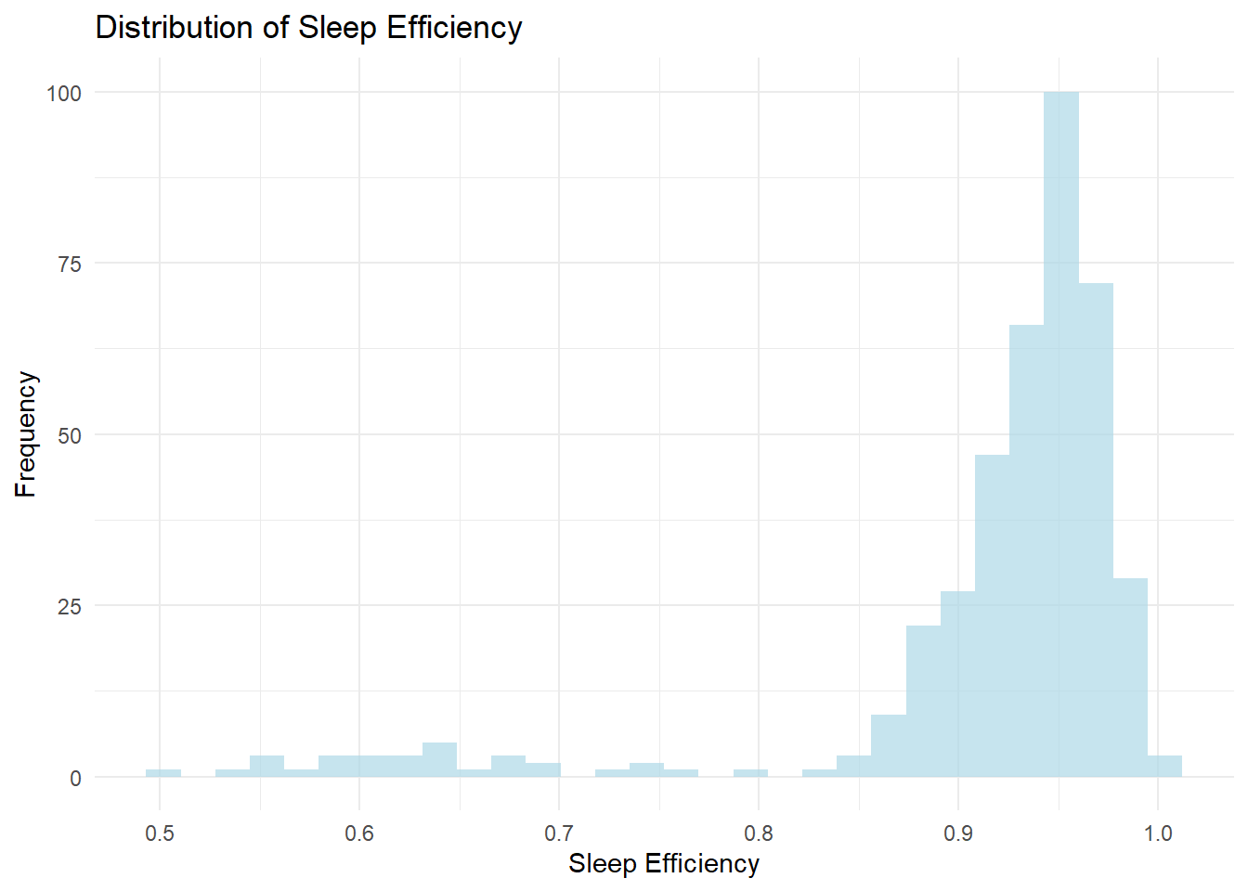
Visualization
Insights: If many users has low sleep efficiency, Bellabeat can support for better sleep through guided medication for better sleep.

Slide 9
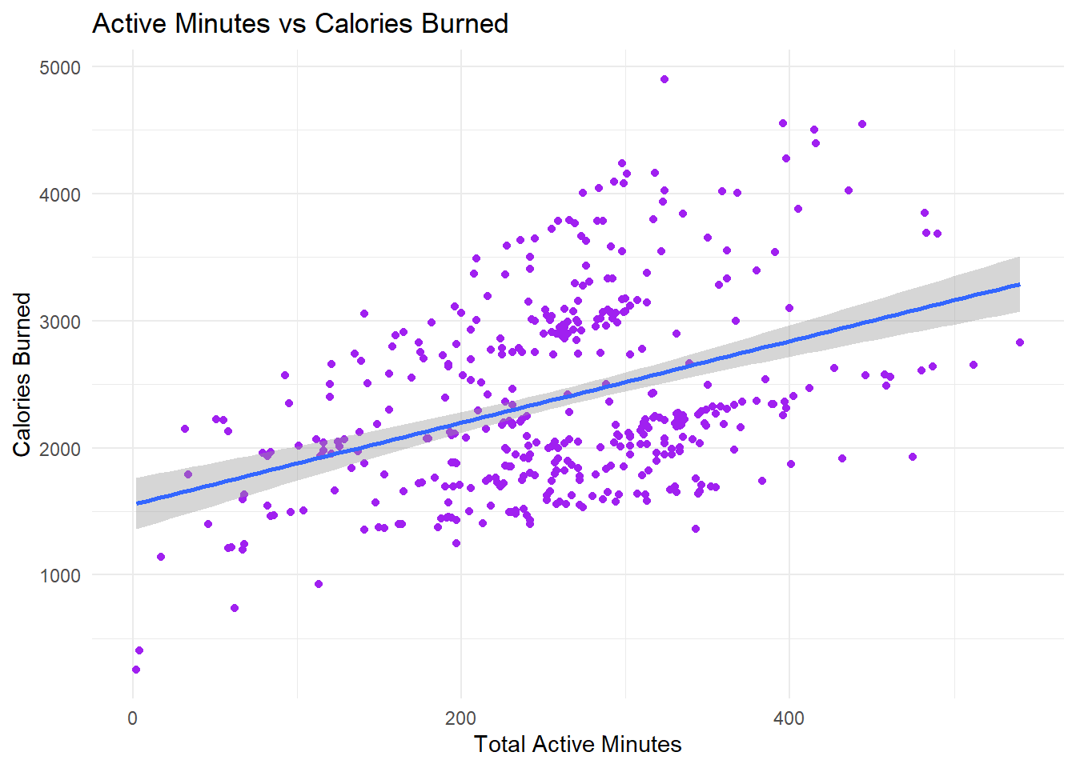
Insights: this can motivate the user that with activity challenge in the app, users can burn more calories with activity. Marketers can engage the users with activity challenge.

Slide 10

Marketing Recommendations
Promote Activity-Sleep Connection:
Market Leaf as improving sleep via increased activity.
Morning & Evening Routine Campaigns:
Create content around popular activity times.
Weekend Challenges:
Encourage weekend activity through app-based challenges.
Personalized App Notifications:
Reminders for steps to achieve better sleep.
Educational Content:
Blogs, social media tips on activity & wellness.

Slide 11

Conclusion
Implement marketing campaigns based on insights.
Further analyze data from actual Bellabeat users.
Conduct A/B testing to evaluate campaign success.
Need user’s demographic data for further analysis.

Slide 12
Thank You for Your Attention!
Questions & Discussion

